Slide 1
Knowledge Graph Convolutional Networks for Recommender Systems
WWW-2019
汇报人：高钰澜 2021年3月7日

Slide 2
Catalogue
1
Background
2
Model
3
Experiments
4
Conclusion

Slide 3
Background

Slide 4
Background
the problem of CF based recommender systems
· sparsity
· cold start
method：collect attributes of users and items
In general, the attributes are not isolated but connected with each other, which forms a knowledge graph (KG).
· precision
· diversity
· explainability
Notes:
CF有什么问题，利用知识图谱来做推荐，有什么好处

Slide 5
Despite the above benefits, utilizing KG in RS is rather challenging due to its high dimensionality and heterogeneity.
· knowledge graph embedding (KGE) (e.g.,TransE and TransR h + r = t）
· meta-path/meta-graph based (e.g., PER and FMG）
KGCN

Slide 6
Model

Slide 7
a set of M users
a set of N items
The user-item interaction matrix
e.g., the triple (A Song of Ice and Fire, book.book.author, George Martin)

Slide 8
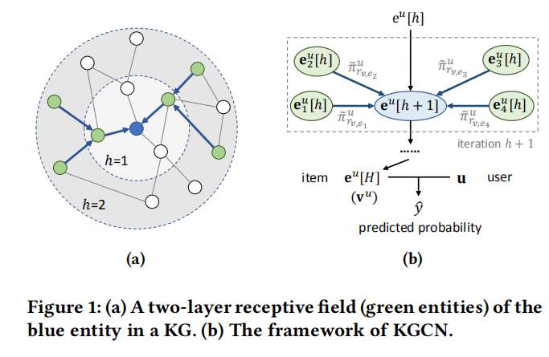
Model

Slide 9
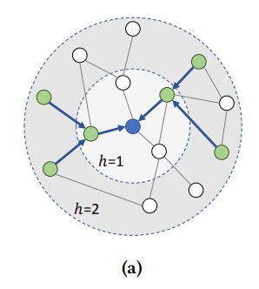
KGCN Layer

Slide 10
• Sum aggregator
• Concat aggregator
• Neighbor aggregator

Slide 11
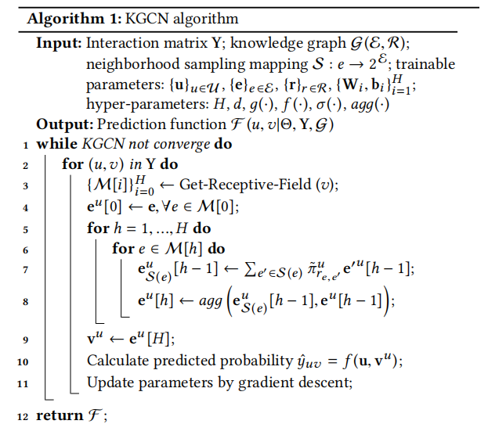
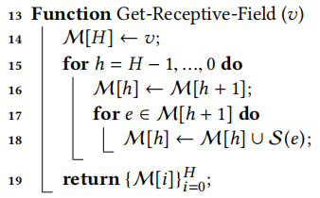

Slide 12
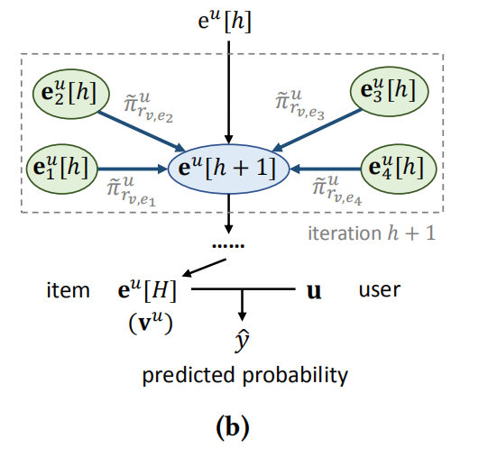

Slide 13
Experiments

Slide 14
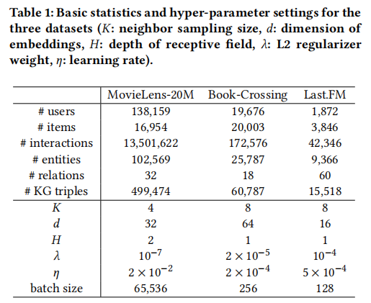
Dataset
We utilize three datasets in our experiments for MovieLens-20M（movie）, Book-Crossing（book）, and Last.FM（music） recommendation

Slide 15
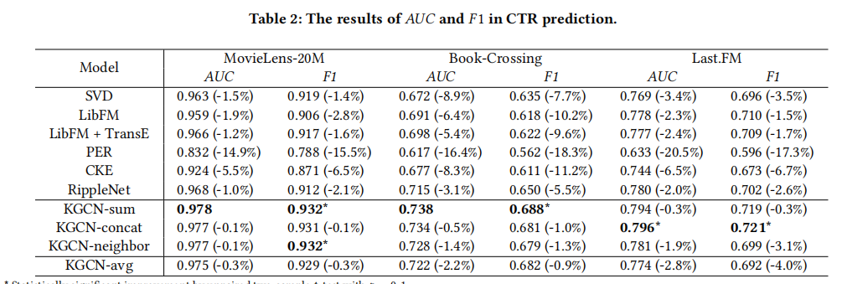
Experiments
The results of CTR prediction and top-K recommendation are presented in Table 2 and Figure 2

Slide 17
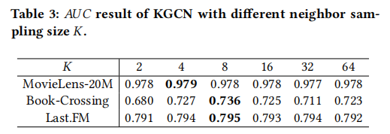
Impact of neighbor sampling size

Slide 18
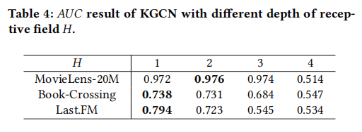
Impact of depth of receptive field

Slide 19
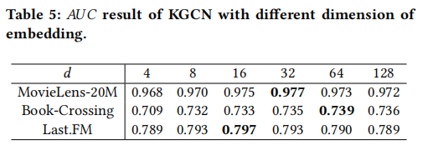
Impact of dimension of embedding

Slide 20
Conclusion
· This paper proposes knowledge graph convolutional networks for recommender systems.
· KGCN extends non-spectral GCN approaches to the knowledge graph by aggregating neighborhood information selectively and biasedly, which is able to learn both structure information and semantic information of the KG as well as users' personalized and potential interests.
· We also implement the proposed method in a minibatch fashion, which is able to operate on large datasets and knowledge graphs.

Slide 21
Thank you for watching

